Slide 1
Immunodietica Tissue-Expression Weekly Update
August 22nd, 2019

Slide 2
Pipeline Automation & WIP Updates
Using UniProt Protein names to obtain Gene Symbol seemed error-prone
Rewrote new code which utilized UniProt Accession ID (6-Digit Alphanumeric ID)
After that, rewrote new improved version of both scripts to try and improve success rate/decrease failure rate (target rate = <5% failure)
Ran new and improved code on big dataset
Pipeline now is fully automated (from epitopes to visualization)
Wrote python subscripts that utilize database APIs to go from ID to gene symbol
Prints out summary stats after finishing pipeline (graphed on next slide)
Unfortunately, did not have time to work on R plots
Cleaned-up and wrote comments for all code in pipeline automation

Slide 4
Pipeline Automation Results
Original Script → As high as 20% failure rate (unmatched epitopes)
Improved Script → Consistently <5% failure rate (even on big dataset)
Originally, using protein names could not be automated to obtain gene symbol
Wrote script that used UniProt Accession ID which could utilize APIs to find gene symbol
Surprisingly, using ACC ID had significantly lower hit rate compared to protein name
Developed complicated code that uses db2db API to use protein name to obtain gene symbol instead

Slide 5
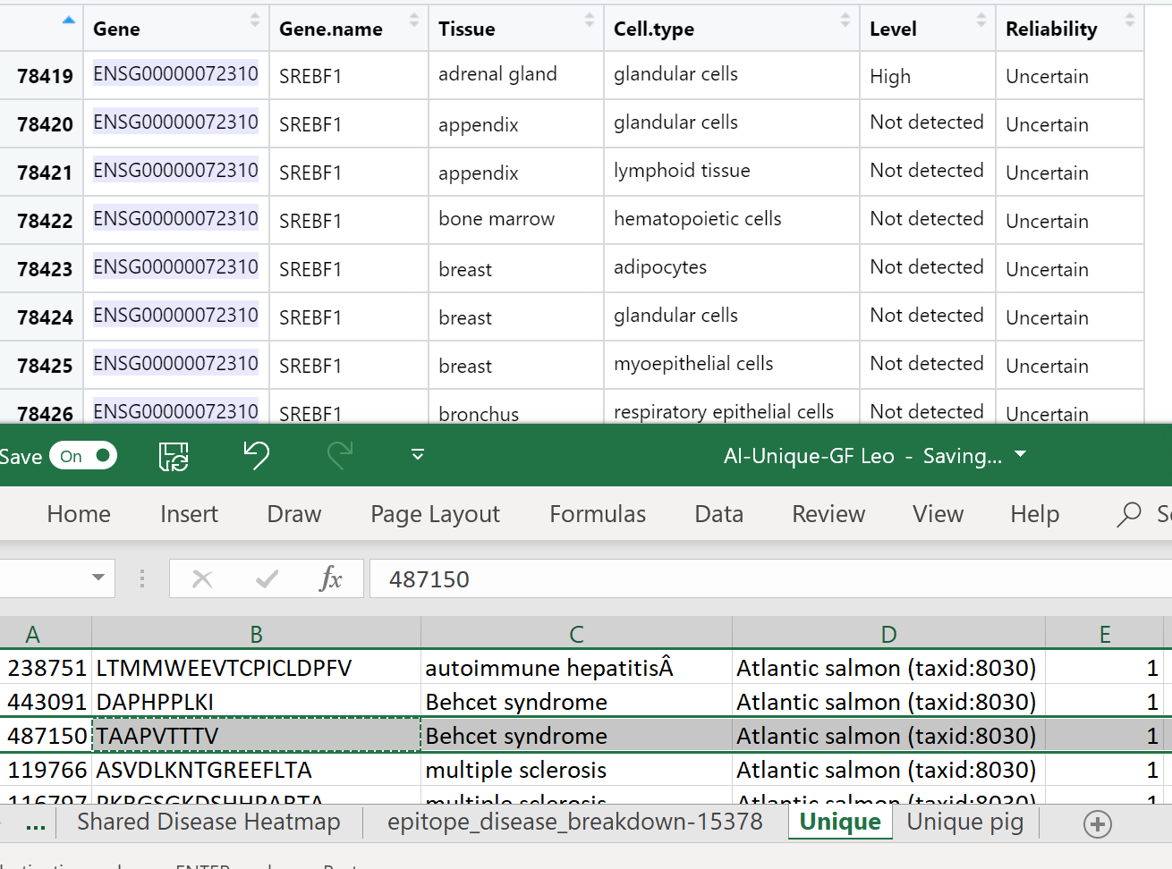
Problems/Issues
A number of the entries only have “Uncertain” or “Not Detected” for tissue-specificity
Filtered out and will not be displayed on R plots
Many, many duplicate entries in big dataset (same epitope, different organism)
Not sure if necessary to keep each instance or remove duplicates for plots

Slide 6
Next Things to Accomplish:
Resume work on R portion of script:
Produce several different levels of tissue-specificity plots
Integrate into rest of pipeline so everything is fully automated and can be run on over AWS
Update GitHub repository so all code is documented and can be downloaded and run on any machine

